Slide 1
AI: Some (Biased) Highlights
CSE 15
Sources:
  Russell’s slides (http://www.cs.berkeley.edu/~russell/ai.html)
  Hoffman/Sammut slides (http://www.cse.unsw.edu.au/~cs3411/)
  Few things of my own
  Introductory article about AI (McCarthy):
    http://www-formal.stanford.edu/jmc/whatisai/whatisai.html

Slide 2
What is AI?
Categories for definitions of AI
Classic View
Modern approach
Systems that think like humans | Systems that think rationally
Systems that act like humans | Systems that act rationally

Slide 3
The Turing Test: Preliminaries
Designed by Alan Turing (1950)
The Turing test provides a satisfactory operational definition of AI
It’s a behavioral test (i.e., test if a system acts like a human)
Problem: it is difficult to make a mathematical analysis of it

Slide 4

The Turing Test
The Turing Test: a computer is programmed well enough to have a conversation with an interrogator (for example through a computer terminal) and passes the test if the interrogator cannot discern if there is a computer or a human at the other end
?
machine
?

Slide 5
The Turing Test vs. AI Fields
For a program to pass the Turing Test, it needs to pass the exhibit the following capabilities:
Communication & perception
Natural language processing
Knowledge representation
Automated reasoning
Machine learning
Topics of AI course
(CSE 324)

Slide 6
Loebner Prize
Each year (since 1994) a competition is made to see if a computer passes the Turing Test
The first program to pass it will receive 100k
Controversial: Minsky offer $100 if anyone finish it
Still, it is interesting to observe capabilities
Machines seems to have come close to fulfill Turing’s prediction (5 minutes)

Slide 7
Other Predictions from Turing
Predicted that by the year 2000 a computer will have 30% chances to fool a person for 5 minutes
Anticipated the major argument against AI:
  The mathematical objection to AI

Slide 8
The Mathematical Objection to AI:
The Halting Problem
Can we write a program in a C++, that recognizes if any program written in that language ends with a given input?
i = 2
While ( i ≠ c)
i++
Does this program terminates for:
c = 1?
c = 10?
No
Yes
Answer: No (Turing, 1940’s!)
Mathematical Proof (CSE 318: Automata Theory): valid for any program running on yesterday’s, today's and tomorrow’s (foreseeable future) computers

Slide 9
Parenthesis: Halting Problem
Proof by contradiction: assume that there is a program H that can determine if programs halt with a given input
What would happen if we give H itself as input for H?
We will obtain a paradox, similar to the one in the set:
  “Pedro shaves only the people who doesn’t shaves themselves”
  Does Pedro shaves himself?

Slide 10
The Mathematical Objection to AI
Argument against AI: a human can determine if a program ends or not
Thus, computers are inferior as humans
Argument against this argument:
  Are you sure that a human will be able to determine if a very complicated program will terminate with a certain input?

Slide 11
AI: Genesis
Logical reasoning calculus was conceived (Leibniz, 17 century)
Leibiz’ motivation: solve intellectual arguments by calculation
Boolean logic (Boole, 1847)
Predicate Logic (Frege, 1879): Begriffsschrift
Incompleteness Theorem (Goedel, 1940’s)

Slide 12
AI: Some Historical Highlights
Turing’s article about what machines can do
Term AI is coined at the Dartmouth conference (1956)
General Problem Solver (Newell & Simon; 1958)
Period of great expectations

Slide 13
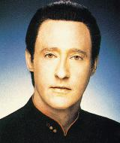
Early Stages, Great Expectations
(what they thought they could achieve)
Jenna: What were you just thinking?
Data: In that particular moment, I was reconfiguring the warp field parameters, analyzing the collected works of Charles Dickens, calculating the maximum pressure I could safely apply to your lips, considering a new food supplement for Spot...
Jenna: I'm glad I was in there somewhere.
(from the episode “In Theory” )

Slide 14
AI: Some Historical Highlights (cont’d)
Perceptrons: limits to neural networks (Minksy and Papert; 1969)
Knowledge-based systems (1970’s)
AI becomes an industry. Early successes of Expert systems

Slide 15
AI: Some Historical Highlights (cont’d)
It becomes clear that expert systems are hard to create (problem known as the Knowledge Acquisition bottle-neck)
1990’s: more consolidated approaches to AI, more realistic expectations, fielded applications:
  Program beats chess world champion
  Applications of machine learning to data-mining (CSE ???: Data Mining)
  Applications of Case-Based Reasoning to help-desk systems (CSE 395/495: Intelligent Decision Support Systems)

Slide 16
Case-Based Reasoning: Definition
A problem-solving methodology where solutions to similar, previous problems are reused to solve new problems.
Notes:
  Intuitive
  AI focus (knowledge representation, reasoning, learning)
  Case = <problem, solution>

Slide 17
Problem-Solving with CBR
CBR(problem) = solution
Problem Space
p₂
p₃
p?
p?
p₁
Solution Space
s₄
s?
s₁
s₃
s₂

Slide 18
CBR: First Example
Specification
Example: Slide Creation
1. Retrieve
New Slides
5. Retain
Repository of Presentations:
5/9/01: ONR review
8/20/02: EWCBR talk
4/25/03: DARPA review
New Case
Slides of
Talks w/
Similar
Content
- 12/1/03: talk@ cse15
4. Review
Talk@
cse15
Revised
talk
3. Revise
2. Reuse
First draft

Slide 19
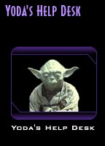

Other Applications of CBR
Help-Desk Systems
Help users when problem occurs
Reduce overhead by lowering number of required support personnel.
"Help you I can, yes, hmm?"

Slide 20
What is Going on the Other Side
Space of known problems for Tie Fighter
Windows 95? Yes
DirectX? No
…
Update DirectX
drivers!
Search is performed for a similar case

Slide 21
What Attributes to consider for Similarity: ICM-Principle
  Independence: Attributes should represent independent features whenever possible
  Completeness: the attributes should be sufficient to determine if the case can be reused in a new situation
  Minimalist: The only attributes that should be included in a case are those used in to compute similarity
(example: price paid for game is not relevant to identify problem running it)

Slide 22
AI Planning
Planning problem: Obtain a sequence of actions (plan) to achieve some goals in a particular situation
situation
goals
A
B
C
C
A
B
plan
move-C-from-A-to-Table
move-B-from-Table-to-C
move-A-from-Table-to-B

Slide 23
Search Space
A
C
C
B
B
A
C
B
A
B
A
C
B
C
B
A
C
A
B
C
B
A
B
A
C
A
C
A
A
B
C
B
C
C
B
A
A
B
C

Slide 24
Hierarchical Task Network (HTN) Planning
Principle: complex tasks are decomposed into simpler tasks. The goal is to decompose compound tasks into primitive tasks, which define actions changing the world.
Travel(UMD,National)
Travel from UMD to Lehigh University
Travel(UMD,National)
alternatives
Travel by car
Taxi(UMD,UMD-Metro)
Travel by plane
Metro(UMD-Metro,National)
Fly(National, L.V. International)
Enough money for air
fare available
Enough money
for gasoline
Travel(L.V. Int’nal,Lehigh)
Taxi(L.V. Int’nal,Lehigh)
Seats available
Roads are passable

Slide 25
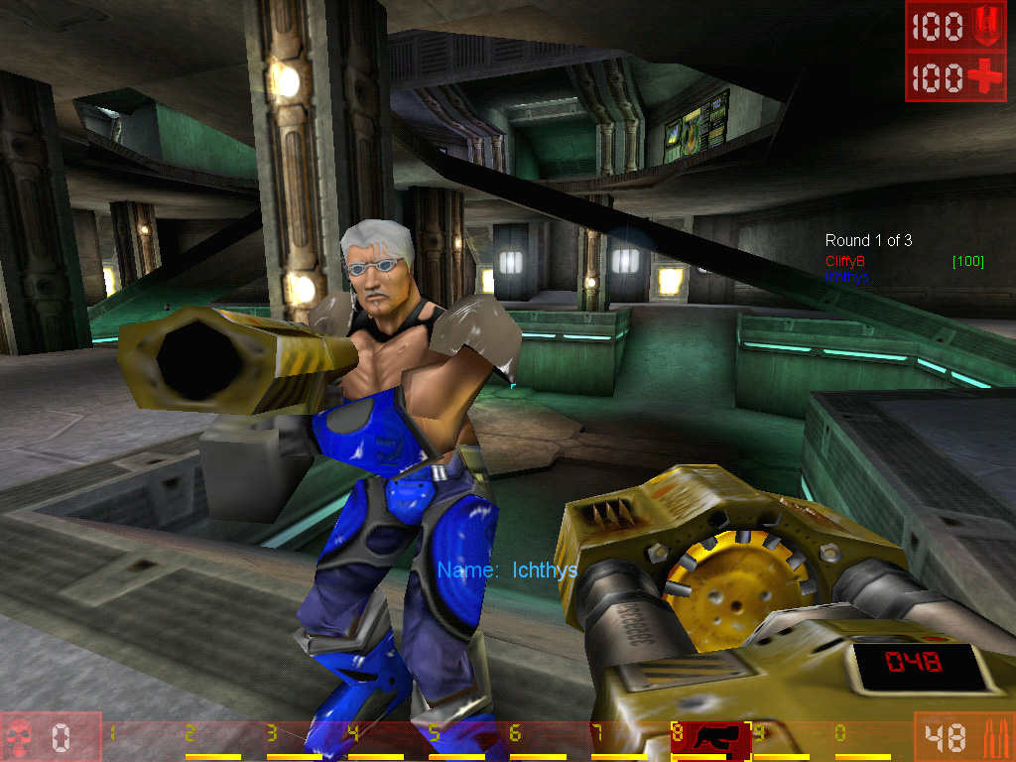
Current Research: Controlling Unreal Tournament Bots

Slide 26
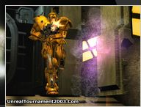
BOTS
Bot: software robot
Receives information from the environment (game server)
Represents knowledge about environment, beliefs, goals
Acts according to knowledge (reason)
Can learn from previous experiences

Slide 27


Using HTNs to Represent Strategies
Capture the flag:
Must bring the enemy’s flag to our camp
Must not allow the enemy to take the flag
E
C
1 2
D
B
A
CTF
capture(2,E)
Move(1,2,B)
defend(1,B)

Slide 28
Use HTN Planning to Reason and Act
2
E
C
1 2
1,2
D
B
A
CTF
capture(2,E)
Move(1,2,B)
defend(1,B)

Slide 29
How Can We Determine an Adequate Strategy?
Use CBR!: View strategies and their situations (ICM-principle) as cases
Map
Own team
Enemy
…
Define a similarity metric for comparing situations
Encode algorithms to compute this similarity very fast (real time!)

Slide 30
What Can the Bot Learn?
New strategies: after every game store the strategy and make it available for future games
Learn the similarity metric: some attributes are more important than others (for example, point B in the previous map seems crucial)
Mistakes: some strategies maybe better than others

Slide 31

But hasn’t Half-Life Done This?
Half life: the best (?) first-person shooter with an amazing computer opponent (or “AI” as the game industry calls it)
A military squad will act coordinately to attack you
The behavior of the AI is hard-coded for the particular situation, you are always approaching from the same direction!
What the computer industry calls “AI” is just a synonym for computer opponent. This can be hard-coded, or cheat, or use true AI techniques (Close Combat, Black and White)

Slide 32
Current Status
We developed an object-oriented architecture and connected it to the Unreal Tournament server (Todd Fisher)
We are developing an HTN-based language for representing strategies (almost done)
We are developing similarity assessments and algorithms for computing these quickly

Slide 33
Conclusions
AI is moving away from the idea of simulating humans and it is rather concentrating on developing programs that behave rationally
But many of the techniques in use now are derived from the initial goal of simulating humans
There is a broad range of deployed systems, companies using AI
Key issues of AI: knowledge representation, reasoning, and machine learning
Mathematical foundations are very important to understand the limitations of computing (CSE 318, CSE 340)

